Slide 1
SOEN 343
6a. API doc generation

Slide 2
Learning objectives
Understanding the importance of documenting API
Understanding the advantages of automated API documentation against manual API documentation
Remember the syntax of JavaDoc for adding comments to Java Code
Applying JavaDoc for automatically generating documentation
Remember Java Doc style and guidelines for documenting an API

Slide 3
API documentation generation tools
Historically, manual documentation generation was used to write API documentation to help developers to understand how to use libraries or modules
Good API documentation is necessary for libraries to be widely accepted and used correctly and efficiently
Manual documentation has many disadvantages:
Very time-consuming to write
Error-prone
Requires dedication and time to update
Outdated or wrong API documentation may be worse than having none

Slide 4
API documentation tools
The goal of having API documentation is to make the software more understandable, decreasing the amount of time the programmers spend in learning how to use libraries/modules/classes
To be really useful and economically viable, the time to write/maintain API documentation must be less than the time it allows to save by its use
API documentation became much more useful with the advent of hypertext and automation tools
Hypertext enables very efficient browsing through huge documentation
Automated tools can be used to extract API documentation from code
Lowers the cost of writing/maintaining API documentation though automation
Many such tools now exist, e.g. Javadoc and Doxygen
All of them can generate hypertext documents

Slide 5
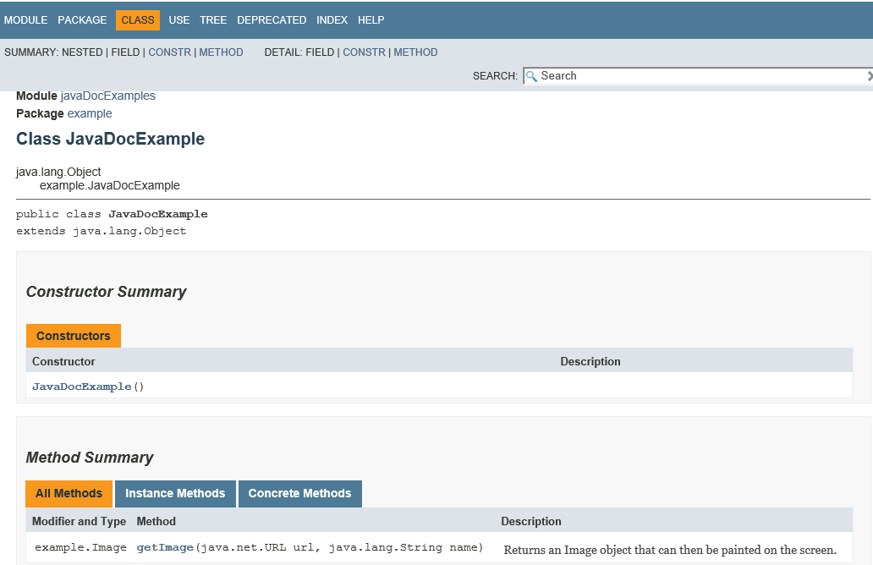


Slide 6
What is JavaDoc?
JavaDoc is a software tool part of Java SDK for generating API documentation from Java source code augmented with special tags in the code’s comments
Javadoc is an industry standard for documenting Java classes
How does JavaDoc work?
Instead of writing and maintaining separate documentation, the programmer writes specially-formatted comments in the Java code itself
The JavaDoc tool is a compiler that reads these comments and generates an API documentation out of them

Slide 7
Advantages and drawbacks
Advantages:
Program documentation process is coupled with the programming process
Automated generation of documentation: less error-prone
Efficient generation of documentation
Efficient update of documentation
Short code-to-documentation cycle: all programmers can be made aware of others’ developments almost in real time
Can generate highly browsable documentation, accessible electronically over the web (HTML)
Disadvantages:
Learning curve to learn how to use the tool, though it is minimal
Requires dedication, or else the documentation will be obsolete or incomplete

Slide 8
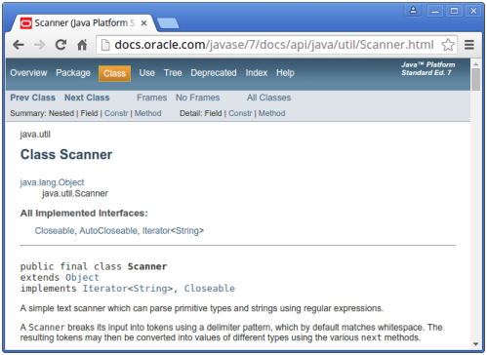
Examples

Slide 9
JavaDoc comments
A JavaDoc comment begins with the /** marker and ends with the */ marker. All the lines in the middle start with an asterisk lined up under the first asterisk in the first line‡
/**
* This is a <b>javadoc</b> comment.
*/
Because JavaDoc generates HTML files, any valid HTML can be embedded. A JavaDoc comment may be composed of multiple lines, for example:
/**
* This is line one.
* This is line two.
*
* This is intended as a new paragraph.
*/
‡ Starting with Javadoc 1.4, the leading asterisks are optional.

Slide 10
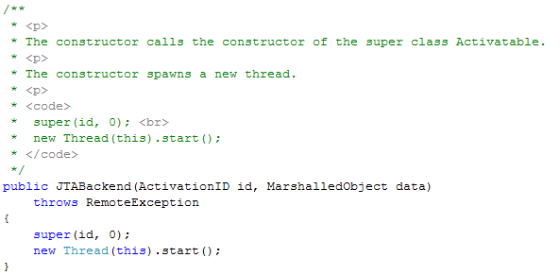
JavaDoc comments
Another useful HTML marker is <code>, which we can use to include a sample code in a JavaDoc comment. Any text between the <code> and </code> markers will appear in a Courier font

Slide 11
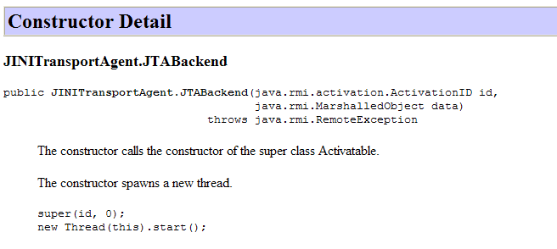
JavaDoc comments
Generates browsable HTML, where every identifier is a clickable link that leads you to its own documentation.

Slide 12
JavaDoc comments
For the JavaDoc comments to be recognized as such by the javadoc tool, they must appear immediately before the class, interface, constructor, method, or data member declarations
The first sentence is a “summary sentence”. This should be a short description of the element described by the comment.
Note:
JavaDoc does not provide a format for commenting elements within methods, i.e. the local variables and the computing going on inside the methods. But you still can use the regular comments marks // or /*..*/, to comment this part of your program

Slide 13
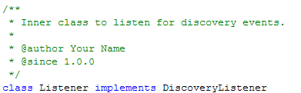
JavaDocs tags
There are a number of special tags we can embed with the JavaDoc comments. These tags start with the “at” symbol @
JavaDoc tags must start at the beginning of a line
Example:
However, information provided in tags such as @author , @version and @since pertain to versioning, which is maintained by a versioning system
Some say it should not be used, as it is superfluous if using a versioning system

Slide 14
JavaDocs tags
@param
Used to add a parameter description for a method. This tag contains two parts: the first is the name of the parameter and the second is the description. The description can be more than one line
@param size the length of the passed array
@return
Used to add a return type description for a method. This tag is meaningful only if the method’s return is non-void
@return true if the array is empty; otherwise return false

Slide 15
JavaDocs tags
@throws
Used to describe an exception that may be thrown from this method. Note that if you have a throws clause, Javadoc will already automatically document the exceptions listed in the throws clause
{@inheritDoc}
Used to copy the description from an overridden method
{@link reference}
Used to link to another documented symbol, or to a URL external to the documentation

Slide 16
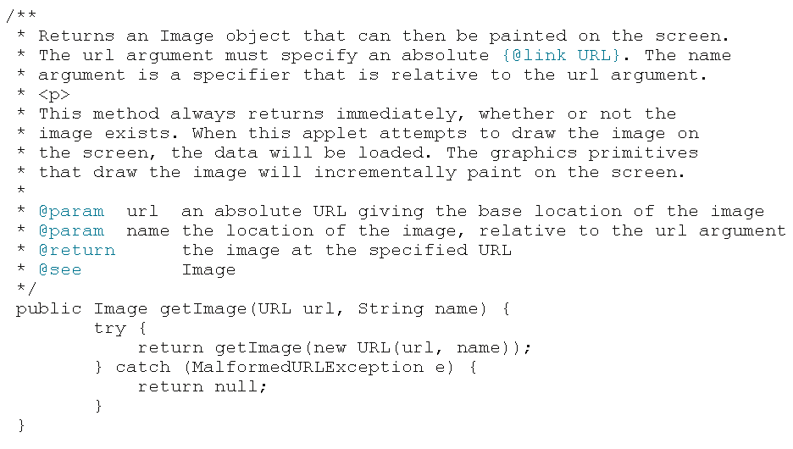
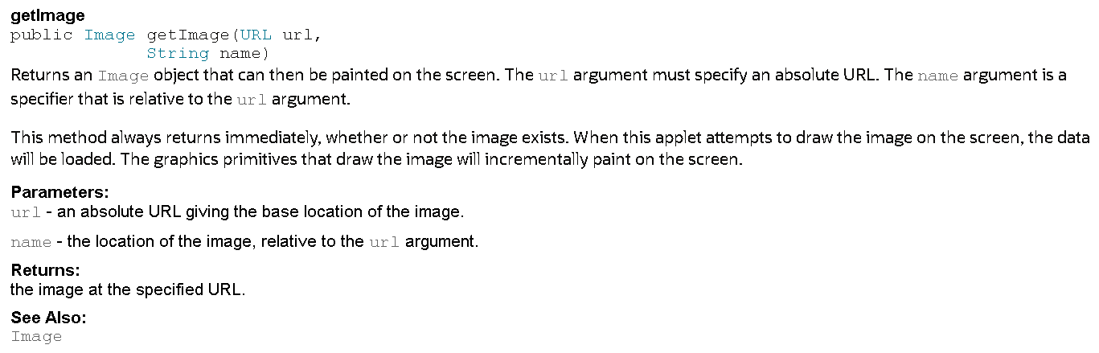
A complete example for a method

Slide 17

JavaDoc style Guide

Slide 18
Style guide
Use <code> style for keywords and names. Keywords and names are offset by <code>...</code> when mentioned in a description. This includes:
Java keywords
package names
class names
method names
interface names
field names
argument names
code examples

Slide 19
Style guide
Omit parentheses for the general form of methods and constructors
When referring to a method or constructor that has multiple forms, and you refer to a specific form, use parentheses and argument types
For example, ArrayList has two add methods: add(Object) and add(int, Object):
The add(int, Object) method adds an item at a specified position in this arraylist
However, if referring to both forms of the method, omit the parentheses altogether
Include the word "method" to distinguish it as a method and not a field
The add method enables you to insert items. (preferred)
The add() method enables you to insert items. (avoid when you mean "all forms" of the add method)

Slide 20
Style guide
OK to use phrases instead of complete sentences, in the interests of brevity This holds especially in the initial summary and in @param tag descriptions
Use 3rd person (descriptive) not 2nd person (prescriptive) The description is in 3rd person declarative rather than 2nd person imperative
Gets the label. (preferred)
Get the label. (avoid)
Class/interface/field descriptions can omit the subject and simply state the object These API often describe things rather than actions or behaviors:
A button label (preferred)
This field is a button label (avoid)

Slide 21
Style guide
Use "this" instead of "the" when referring to an object created from the current class
For example, the description of the getToolkit method should read as follows:
Gets the toolkit for this component (preferred)
Gets the toolkit for the component (avoid)
Be clear when using the term "field“ (two meanings)
static field, which is another term for "class variable"
text field, as in the TextField class. Note that this kind of field might be restricted to holding dates, numbers or any text. Alternate names might be "date field" or "number field", as appropriate

Slide 22
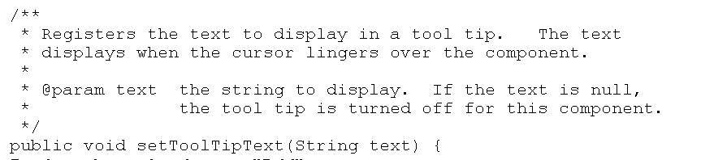
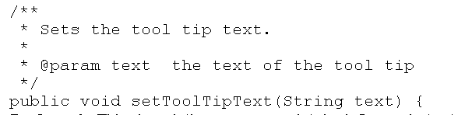
Style guide
Add description beyond the API name
The best API names are "self-documenting", meaning they tell you basically what the API does. If the doc comment merely repeats the API name in sentence form, it is not providing more information
The ideal comment goes beyond those words and should always reward you with some bit of information that was not immediately obvious from the API name

Slide 23
Summary
Having an API documentation aims at improving the productivity of programmers by increasing the readability and understandability of code
The Javadoc code itself also provides documentation within the code
Manual documentation is extremely tedious and error-prone
Automated API documentation generation tools exist that automate the generation of API documentation
Automated API tools results in more efficiency in writing/maintaining the API documentation, thus more overall productivity
API documentation requires dedication and rigor

Slide 24
References
Oracle Corporation. Javadoc Tool.
Oracle Corporation. How to Write Doc Comments for the Javadoc Tool.
Wikipedia. Comparison of document generators.

